Slide 1

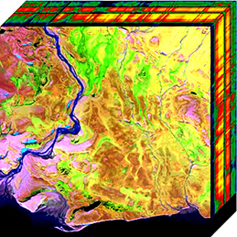
Hyperspectral Image Detection
Or Mizrahi, Arie Rozental

Slide 2
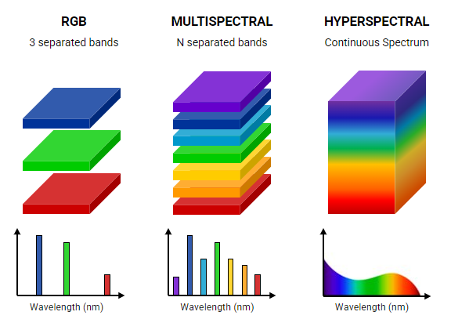
Background
An hyperspectral image is an image that contains a vast amount of information.
Regular RGB images contain three color channels per pixel, spanning the visible light spectrum (380nm-750nm), whereas hyperspectral images contain dozens to hundreds of color channels. These channels can extend beyond the visible spectrum, above 750nm (near-infrared, NIR) and below 380nm (ultraviolet, UV).
Each pixel in a hyperspectral image provides a detailed spectral signature, which acts like a "fingerprint" for different materials - This allows for the precise identification and differentiation of objects and substances based on their unique spectral properties.

Slide 3
Motivation
Defense and Security– Remote identification of dangerous substances.
Early Disease Detection – Identifying abnormalities in tissues through hyperspectral imaging.
Planetary Surface Exploration – Identifying minerals and materials on planets using spectral data.

Slide 4
Problem Description
Currently, various algorithms exist for object detection in hyperspectral images, but they do not achieve sufficiently accurate results.
Our goal is to develop an algorithm that addresses this issue and achieves higher accuracy than the existing algorithms, using deep convolution neural networks.

Slide 5
Problem Description - cont
The existing algorithms estimate the covariance matrix of the hyperspectral image, and inserts the estimated matrix into a detection algorithm.
The problem lies in the estimation of the covariance matrix, which often results in an almost singular matrix. Detection algorithms do not perform well with such matrices. We aim to solve this issue.

Slide 6

The existing algorithm
Input:
Hyperspectral image
Objective vector
Output:
ROC (Receiver Operating Characteristic)
Log-likelihood score: $ℓ(z;C)=z^{T}C^{−1}z+log∣C∣$
Hyperspectral Image
Deep Neural Network
Covariance Matrix
Detection Algorithm

Slide 7
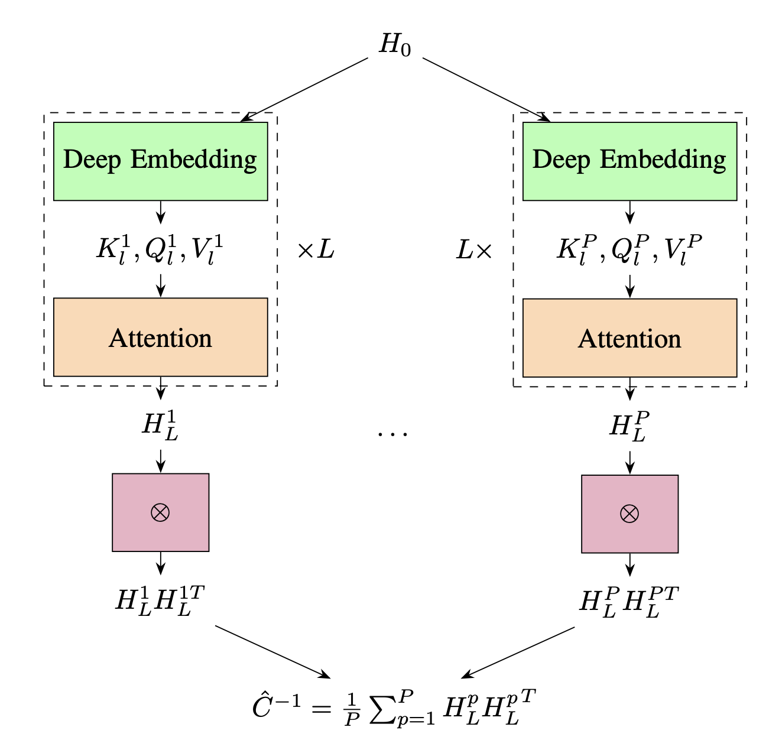

The existing algorithm Architecture
Input Representation $H_{0}$ - an hyperspectral image which can be seen as a high-dimensional feature embedding of the raw input data
Deep Embedding Layer – a deep neural network, with convolution layers, fully connected layers, and activation layers (ReLu) which outputs $K_{l} , Q_{l} , V_{l}$ matrices.
Attention Layer - Attention allows the model to capture long-range dependencies between features and it is repeated for multiple layers L. Each layer’s output, $H_{L}^{p}$ represents a transformed, context-aware feature embedding.

Slide 8

The existing algorithm Architecture - cont
Covariance Matrix Computation - The extracted embeddings $H_{L}^{p}$ are used to compute the inverse covariance matrices. Each sample covariance matrix is computed as $H_{L}^{p}H_{L}^{pT}$
The final estimated covariance matrix ${\hat{C}}^{−1}$ is obtained by averaging over multiple samples ${\hat{C}}^{−1}=\frac{1}{P}\sum_{p=1}^{P}{H_{L}^{p}H_{L}^{pT}}$

Slide 9
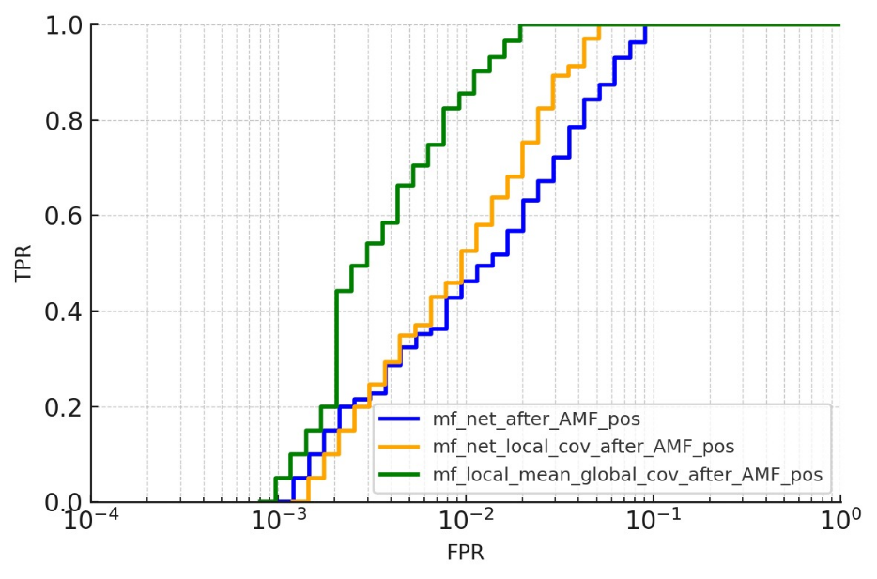

The existing algorithm – results
The existing algorithm utilizes 3 different methods for covariance estimation:
MF_NET – Estimates both the global covariance matrix and the global mean.
MF_NET_LOCAL_COV – Relies on global covariance estimation, and the mean is estimated through the net.
MF_LOCAL_MEAN_GLOBAL_COV – A more advanced approach that combines local mean estimation with global covariance estimation, achieving better performance compared to the other methods.

Slide 10
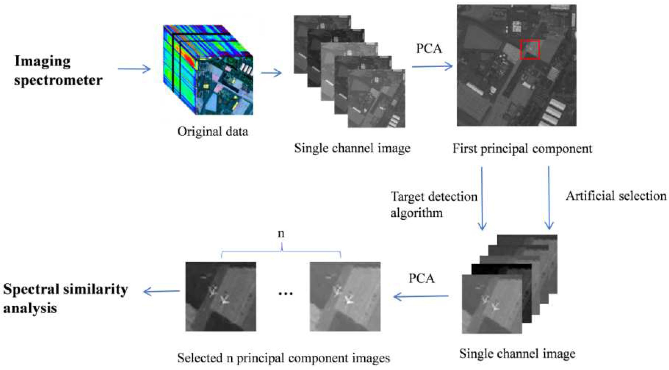
Solution
A classic method used in this case is PCA (Principal Component Analysis) – a technique that identifies the channels that contribute the most to the matrix and discards those that contribute less statistically.
By applying this method, one makes the covariance matrix less singular by reducing its dimensionality. This reduction in dimensionality stabilizes the estimated covariance matrix, making it more suitable for detection algorithms.

Slide 11
The Impact Of The Channels Range
During our model training, we discovered that using PCA alone does not provide more accurate results.
A large number of channels compared to the number of pixels, leads to a nearly singular inverse covariance matrix, causing instability in detection algorithms that rely on matrix inversion.
Therefore, we decided to examine the impact of the amount of channels on the estimation of the inverse covariance matrix.

Slide 12
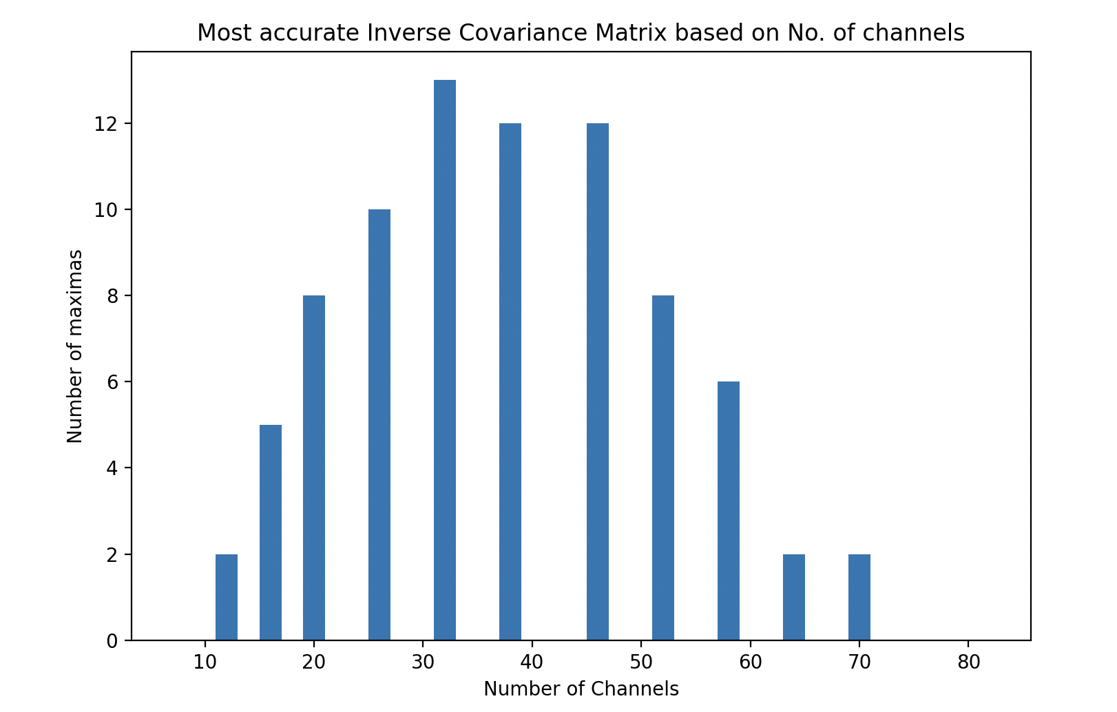

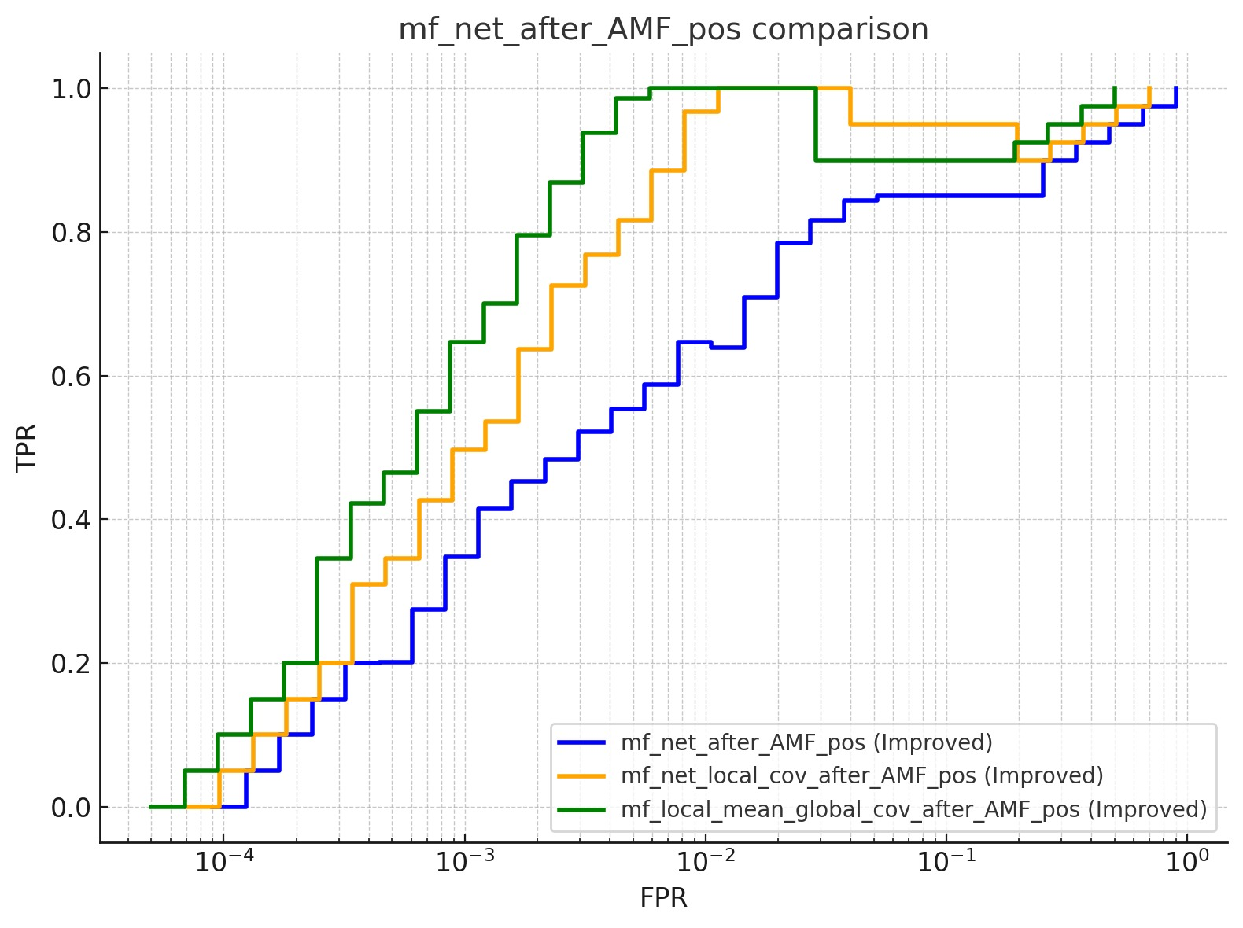
results
During the simulations we conducted, we discovered that the number of channels affects the accuracy of covariance matrix estimation.
We found that within a specific channel range of 16 to 64 channels, there is an approximately 15% improvement in results compared to the original algorithm.
However, outside this range, no further improvement in results is observed.

Slide 13
Conclusions and future experiments
We observed an improvement in results within a specific channel band, raising the question of whether it would be more effective to perform the estimation within specific wavelength ranges or lesser channels.
A more in-depth study should be conducted on the effect of the channel range on the accuracy of covariance matrix estimation.
Future research should explore adaptive methods for selecting the optimal spectral range dynamically, potentially leveraging machine learning techniques to determine the most informative channels for covariance estimation in different scenarios.

Slide 14
The end

